Slide 1
IP Summit 2023
Utah State Bar IP Section
OED’s War Against Rule 11.18 Violations and the Unauthorized Practice of Law: Navigating Ethics Minefields and Avoiding USPTO Discipline
Friday, February 24, 2023
Salt Lake City, Utah
Michael E. McCabe, Jr.
Managing Partner
McCabe Ali LLP

Slide 2
Overview
How it Started
OED Involvement
Growth of UPL in TM Matters
Rule 11.18 Certification Requirements
Disciplinary Trends at USPTO
Best Practices for Compliance
2

Slide 3
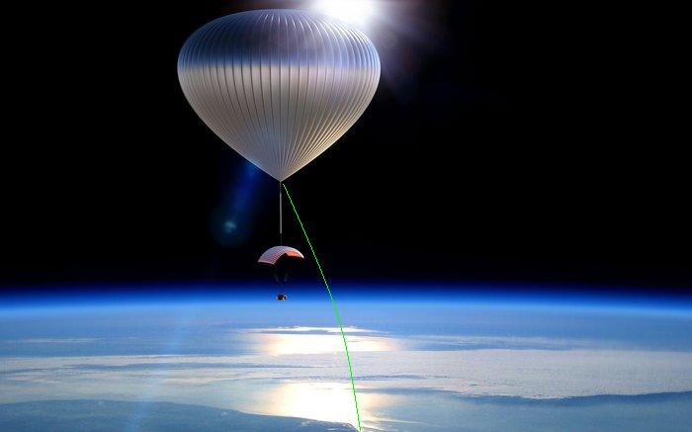
How This “War” Evolved

Slide 4
TM Applications From China
4

Slide 5
TM Applications From China (cont’d)
5

Slide 6
Why The Increase? And Why China?
LEGITIMATE MARKET FACTORS:
Increase of “Made in China” products
Amazon Brand Registry proof of IP rights
"NON-MARKET" FACTORS:
CN government subsidies > US filing fees
CN mandate to increase Madrid Protocol apps by 50%
Ransom or sell marks to legitimate owners
Thwart takedown notices
6

Slide 7
Red Flags of Improper TM Practices
Specimen rejections
Sketchy use claims
Difficulty verifying applicant
Mass filings w/ same address
Unclear who is preparing, signing and/or filing
No U.S. attorney involved
Enforcing U.S. law prohibiting Unauthorized Practice of Law against persons in China not plausible
7

Slide 8
Similar Motivations Increase Focus on Improper Patent Practices
CN subsidies greater than cost of filing U.S. application, plus gov’t quotas, motivate increased filings
Subsidies and quotas motivate divisional filing strategies
Micro entity reduced costs for applicants
IP rights used to block competition
Trademarks and patents in China: The impact of non- market factors on filing trends and IP systems (PTO Jan. 2021)
8

Slide 9
OED Gets Involved

Slide 10
Power to Regulate Practice Before Office
OED investigates ethical misconduct by those engaged in “practice before the Office”
Administrative Procedures Act – Permits anyone licensed in good standing before a court to represent others before an agency in non-patent matters.
5 U.S.C. 500(b)
Patent Act – Permits PTO to admit patent practitioners and discipline anyone appearing before the Office in patent or TM matters
35 U.S.C. 2(b)(2)(D) & 32
10

Slide 11
Power to Regulate: Trademark Practice
Practice before the Office in TM matters includes:
Any law-related service relating to considering or filing TM application;
Clearance opinions on registrability/availability;
Drafting and prosecuting TM applications;
Holding out as authorized;
Agency litigation involving trademarks
37 CFR 11.5(b)(2)
11

Slide 12
Power to Regulate: Patent Practice
Practice before the Office in patent matters includes:
Any law-related service relating to considering or filing patent application;
Patentability opinions;
Drafting specification or claims;
Prosecuting patent applications;
IPRs and other ex parte and inter partes matters;
Holding out as authorized.
37 CFR 11.5(b)(1)
12

Slide 13
PTO Difficulty Regulating TM Misconduct
The USPTO’s Rules of Professional Conduct apply only to “practitioners”
37 CFR 11.101-901 (2013)
China TM applicants mostly pro se
No practical enforcement mechanism over pro se applicants outside the U.S.
USPTO lacks authority to file civil action for UPL against non-practitioner
13

Slide 14
U.S. Counsel Rule – August 2019
Foreign domiciled TM applicants must be represented by U.S. counsel:
Increase compliance
Improve accuracy
Safeguard integrity
U.S. attorney subject to RPCs and discipline for improper TM practices
14

Slide 15
Rule 11.18 - Certifications and Pre-Filing Duties

Slide 16
Rule 11.18 – Truthful Statements
Truth Certification
“All statements made therein of the party’s own personal knowledge are true, and all statements made therein on information and belief are believed to be true.”
- 37 CFR 11.18(b)(1)
16

Slide 17
Rule 11.18 – Reasonable Inquiry
Inquiry Certification
To the best of knowledge, information and belief, formed after an inquiry reasonable under the circumstances—
(i) Not presented for improper purpose;
(ii) Legal contentions warranted;
(iii) Factual contentions evidentiary support;
(iv) Denials warranted on evidence.
- 37 CFR 11.18(b)(2)
17

Slide 18
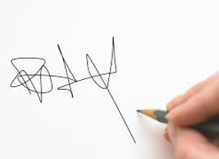
Rule 11.18 – Personal Signature
Signature Certification
“each piece of correspondence filed by a practitioner . . must bear a signature, personally signed by such practitioner, in compliance with §1.4(d)(1) of this chapter . . .” - 37 CFR 11.18(a)
Person signing certifies inserted own sig. or “reasonable basis to believe person whose signature is present was actually inserted by that person.”
- 37 CFR 1.4(d)(2)(i); (d)(3)
18

Slide 19
Rule 11.18: Relationship with Ethical Duties

Slide 20
Meritorious Claims – Rule 3.1
“A practitioner [lawyer] shall not bring or defend a proceeding, or assert or controvert an issue therein, unless there is a basis in law and fact for doing so that is not frivolous. . . .”
37 CFR 11.301; UCJA R. 13-3.1
Rule requires lawyers to:
Inform selves about facts of clients’ cases and applicable law;
Determine they can make good faith arguments in support of clients’ position;
Not abuse legal procedure
UCJA R. 13-3.1 cmt. [1], [2]
20

Slide 21
Candor to the Tribunal – Rule 3.3
“A practitioner [lawyer] shall not knowingly [or recklessly]”:
Make a false statement of fact or law to tribunal;
Fail to correct a false statement of fact or law previously made to tribunal;
37 CFR 11.303(a)(1); UCJA R. 13-3.3(a)(1), (a)(2)
“A practitioner [lawyer] shall not knowingly [or recklessly]”:
Offer evidence known to be false
37 CFR 11.303(a)(c); UCJA R. 13-3.3(b)
21

Slide 22
Competence – Rule 1.1
“A practitioner [lawyer] shall provide competent representation to a client.”
Competency requires “legal knowledge, skill, thoroughness, and preparation reasonably necessary for the representation . . .”
37 CFR 11.101; UCJA R. 13-1.1
22

Slide 23
Aiding UPL – Rule 5.5
“A practitioner [lawyer] shall not practice law in a jurisdiction in violation of the regulation of the legal profession in that jurisdiction, or assist another in doing so.”
37 CFR 11.505; UCJA R. 13-5.5(a)
Lawyers may employ paraprofessionals and delegate functions to them, but lawyer must:
Supervise the delegated work; and
Retain responsibility for their work
37 CFR 11.5; UCJA R. 13-5.5 cmt [2]
23

Slide 24
Client Communications – Rule 1.4
“A practitioner [lawyer] shall . . . . Reasonably consult with the client about the means by which the client’s objectives are to be accomplished”
37 CFR 11.104(a)(2); UCJA R. 13-1.4(a)(2)
“A practitioner [lawyer] shall explain a matter to the extent reasonably necessary to permit the client to make informed decisions regarding the representation”
37 CFR 11.104(b); UCJA R. 13-1.4(b)
24

Slide 25
Discipline Trends From Foreign Applicant IP Representation

Slide 26
Common TM Disciplinary Fact Pattern
Someone from China solicits “cooperation” agreement
Often a trademark “agency” or type of TM filing service
Often contacts U.S. attorney with CN family name
Often the U.S. atty has little or no TM experience
CN “agent” does the legwork, U.S. Atty minimized
The TM agency:
Communicates with applicant, collects specimens, and drafts application;
Sends to U.S. atty for review (sometimes);
Signs application using U.S. atty’s S-sig (sometimes);
Files the application
26

Slide 27
Common TM Disciplinary Fact Pattern (cont’d)
The U.S. Atty:
Reviews draft OBJ file (sometimes)
Signs through TEAS (sometimes) OR authorizes CN agent to S-sign on their behalf (or for client)
Collects payment from referral source/agency
Rarely, if ever, communicates with applicant-client
The results:
Mass numbers of filings;
Specimen rejections;
TEAS meta may prove violation of “personal” signature rule
37 CFR 11.18; 37 CFR 2.193
27

Slide 28
In Re Zhang
Atty admitted March 2019
“Agents” in CN hire Atty to be of record in TM applications prepared by foreign non-attorney
Paid $40-$60 per application
8,500 applications filed in 2020
9,800 applications in 2021
Over 350 applications in a single day
Cursory review
Permitted agent to sign name
Atty agrees conduct misrepresented facts to tribunal, failed to communicate, aided UPL
90-day suspension
In re Zhang, Proc. No. D2022-16 (USPTO July 11, 2022)
28

Slide 29
In Re Wan
“Agents” in CN hire Atty to be of record in TM applications prepared by foreign non-attorney
Before 8/3/19 – 2,500 TM apps
8/3/19 – 3/31/21 – 18,000 TM apps (solo)
Atty entered applicant signature, in violation of personal signature rule
Due to time restrictions from volume, failed to adequately review or communicate
Violated duty of competence, candor to tribunal, and aided UPL
Six-month suspension
In re Wan, Proc. No. D2022-04 (PTO Apr. 11, 2022)
29

Slide 30
In Re Meikle
Company provided paralegal services to TM clients.
Atty ultimate managerial authority over nonpractitioner assistants.
Atty permitted non-practitioner assistants to sign on behalf of named signatory in 35 trademark filings
Violation of “personal” signature certification – Rule 11.18.
In re Meikle, Proc. No. D2019-17 (USPTO, March 21, 2019)
30

Slide 31
In Re Liu
Atty located in Texas
Many TM filings purport to bear his personal signature entered within minutes of each other from various locations around China and California (not TX)
1400 applications
Atty did not conduct an adequate pre-filing review
Violation of “personal” signature certification
Conduct constituted misrepresentation to USPTO, offering false evidence, and failure to cooperate with OED investigation
Excluded on default judgment
In re Liu, Proc. No. D2022-03 (USPTO Aug. 9, 2022)
31

Slide 32
In Re Chew
Patent Agent identified as atty of record on approx. 4,000 design applications filed Aug. 2019 – Sept. 2021.
Certification of micro entity status rejected in 171 apps for exceeding filing limit.
Disciplined for failing to conduct reasonable pre-filing inquiry before filing micro entity certifications
In re Chew, Proc. No. D2023-08 (USPTO Jan. 20, 2023)
32

Slide 33
Best Practices for Compliance

Slide 34
Best Practices for Compliance
Know who is, and is not, your client
Subject matter conflict checks
Watch out for high volume referrals and non-attorneys engaging in practice before Office
Document terms of representation
Rule 11.18 requires not blind rubber stamping-ask questions and demand proof
Enter own signatures
34

Slide 35
THANK YOU!
Michael E. McCabe, Jr.
McCabe Ali LLP
mike@mccabeali.com
301-798-1110
35

